Slide 1
Modern .NET web development with batteries included Showcasing Orchard Core CMS
Your Name
Event, date

Slide 2
Why use a CMS?
No need to reinvent the wheel
It’s also a framework
You get support and a community
Notes:
Explain the general benefits of using a CMS: No need to reinvent common user-facing features like content/user/media management and else, a framework contains developer features and gives you guidelines how to write your code, a community focused on the same thing you do can help and support you a lot.

Slide 3
„Open-source, modular, multi-tenant application framework and CMS for ASP.NET Core”
Notes:
Explain what each of these mean. I.e. what’s open-source and why is it good, what does modular and multi-tenancy mean…

Slide 4
Then let’s see Orchard Core!
.NET 6/7, ASP.NET Core MVC
Open-source (.NET Foundation)
7000 commits, 250 contributors, 6200 issues (4900 closed)
Notes:
Give a quick overview of the project.

Slide 5
Orchard 1.x?
.NET Framework, ASP.NET MVC
11500 commits, 180 contributors, 7400 issues (5500 closed)
Still alive and kicking!
Notes:
Mention that Orchard 1 exists as well and is still supported. Explain the differences to Core and that a lot of apps still use it.

Slide 6
A little bit of history
2009: First commit on CodePlex
2011: Orchard v1.0
2014: First Orchard Core commit
2021: Orchard Core v1.0
Notes:
Give an overview of how Orchard progressed. You can add your personal milestones as well (like when did you start with Orchard). Explain why it took almost 6 years for Core to reach 1.0 (including how .NET Core changed all the time).

Slide 7

+
Notes:
This is for introducing yourself and how you relate to Orchard, and to establish your credibility (i.e. why is it that you talk about Orchard?). Add your profile picture or company logo to the right.

Slide 8
Why Orchard?
ASP.NET Core MVC supercharged
Flexible/extensible content/user/media management, multi-tenancy…
You’ll become a better developer (it’s also written by those who write ASP.NET itself)
Notes:
Explain how Orchard is ASP.NET Core MVC + all the goodies (and what you know about ASP.NET Core all still applies), explain how Orchard has a lot of features but all are also extensible and flexible, explain how you can improve a lot as a developer by getting involved with a quality open-source project like Orchard.

Slide 9
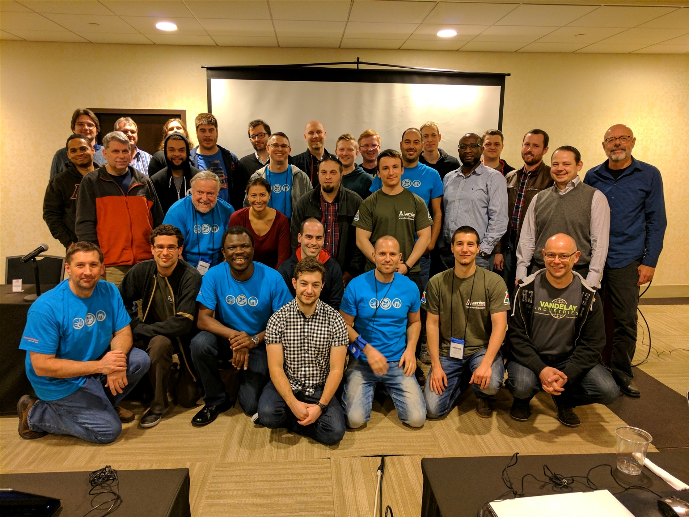
More than software
Notes:
Talk about the community. Add your own personal stories.

Slide 10
This is also Orchard
https://www.playtfr.com/
https://www.rvc.ac.uk/
https://fly.eg/
https://www.houseofblues.com/
https://santamonica.gov/
https://folkways.si.edu/
https://esd.wa.gov/
Also see https://showorchard.com/
Notes:
These are Orchard 1 and Core sites too, so make this clear. Have these open before the presentation so you just need to show them in the browser (you can bookmark them to a bookmark folder so you can easily open them at once).

Slide 11
Demo
Notes:
See the “Demo outline” document for tips on conducting the demo.

Slide 12
Where to host?
Anywhere where .NET runs
IIS, Azure App Service
Docker
DotNest SaaS (https://dotnest.com/)
Notes:
Briefly explain the various options and how do they compare.

Slide 13
I like this! Where do I start?
https://orchardcore.net/
https://orcharddojo.net/ (newsletter, Dojo Course 3)
https://github.com/Lombiq/Orchard-Training-Demo-Module
Notes:
Explain what is on each of these: The official website with links to everywhere, Orchard Dojo containing further resources like the Dojo Course tutorial series and the “This week in Orchard” blog posts (which are also sent out in newsletter form), and the Training Demo module that guides you with code to become and Orchard developer.

Slide 14
Thank you!
Add your contact details here
Notes:
Thank the audience for their attention and have some links and your e-mail address here where they can reach you.

